Slide 1
Shine My Room
Ao Li & Morten Knudsen
12/6-2017

Slide 2
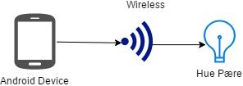
Shine My Room is an app for people with Philips Hue lightbulbs and what to change the light through an app
Concept diagram:

Slide 3
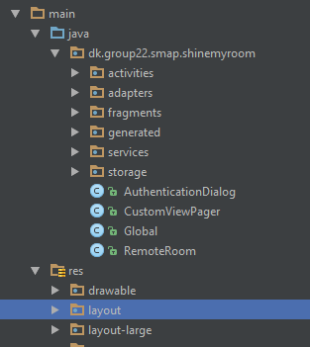
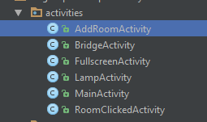
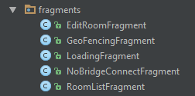

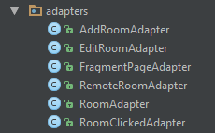

App projekt overview

Slide 4
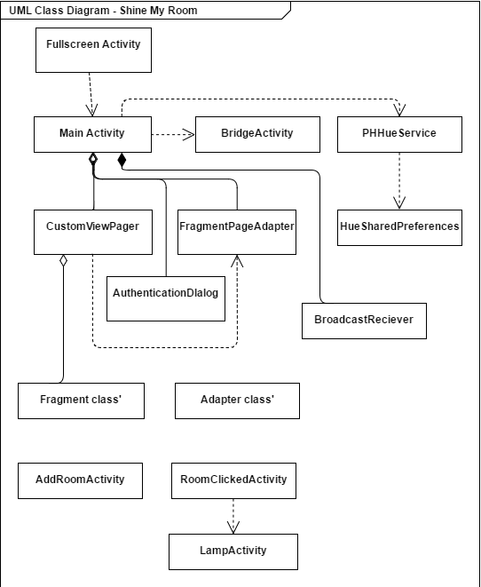
Main components
Activities
Service
Broadcast Receiver
Adapters
Fragments
Storage

Slide 5
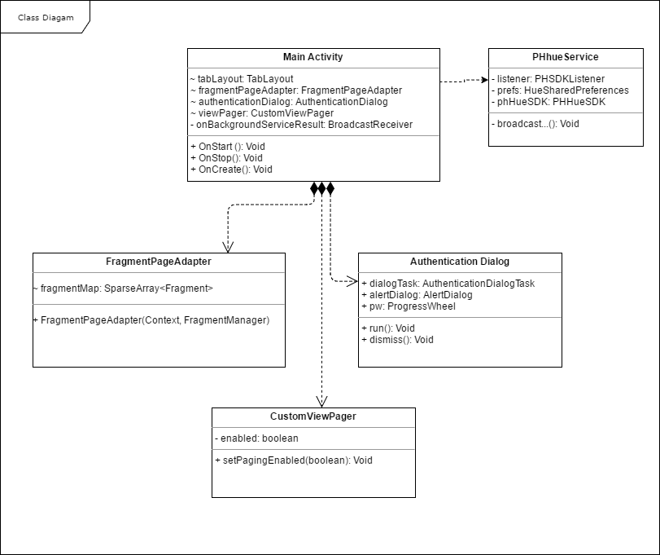
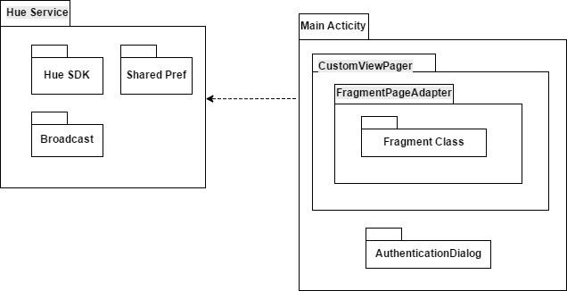

Slide 6
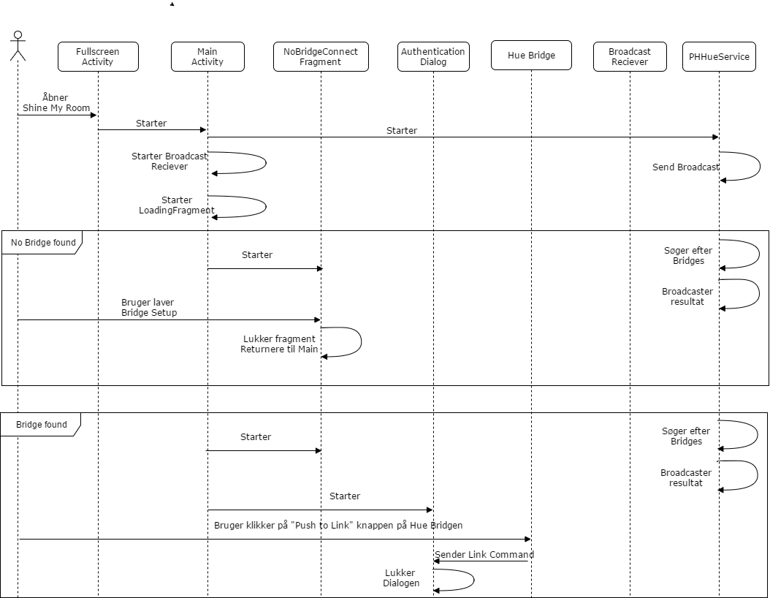
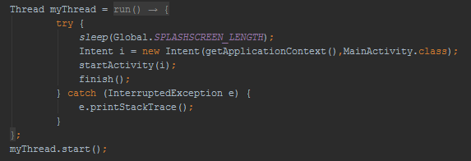
Activities

Slide 7

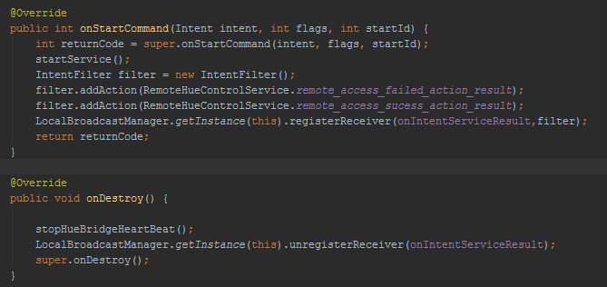
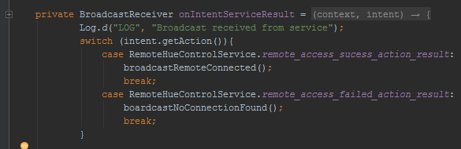
Service & Broadcast Receiver

Slide 8
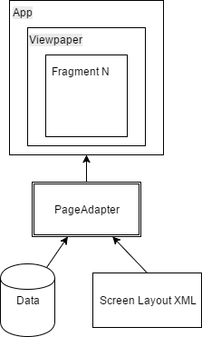
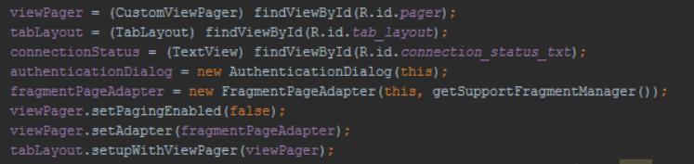
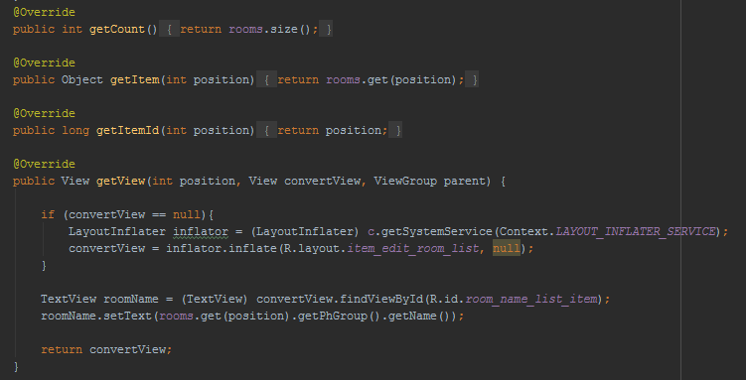
Adapters & Fragments

Slide 9
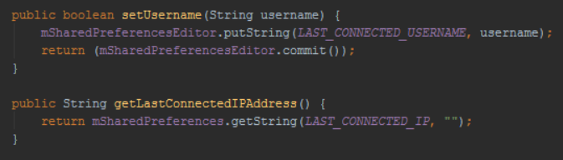
Storage
Shared Preferences

Slide 10
Android Framework
Splash screen, Shared prefrences, Managers, Ressource, Intents, Activities, Service, Broadcast Receiver, Adapters, Fragments, Storage
Geofencing, Color change through ressources,
Pros
”Open Source”, Garbage collection, Easy to start,
Cons
Devices and versions, Changing oritation

Slide 11
Demonstration

